Slide 1

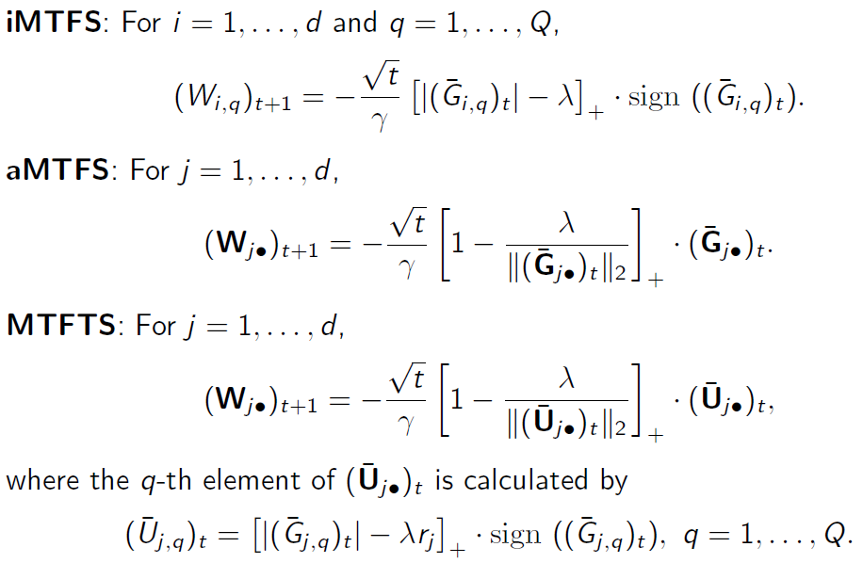
Poster Name [Align Center]
Name University Country Email | Name University Country Email | Name University Country Email
Abstract
Up to 250 words summarizing the research work.
Introduction
The introduction will tell us about what will be shared later on.
You may download the Power Point file as a template for editing your poster.
Methods, Result and Discussion
Detail analysis and discussion of your findings for the poster.
You may include figures/tables for better visualization and illustration purpose.
Conclusion
Conclude your findings for the poster after the methods and results are discussed.
References
Include your references here (if any) that you have referred to when preparing for your poster.
Submission Instructions
The poster submission should be in the PDF or MS Powerpoint format. Please ensure that the poster is in accordance with the guidelines before submitting.

